Slide 1
Dr. Samuel A. Mudd and the “injured Man’
Copyright 2017 by the Dr. Samuel A. Mudd Society. This material may be used for classroom use.

Slide 2
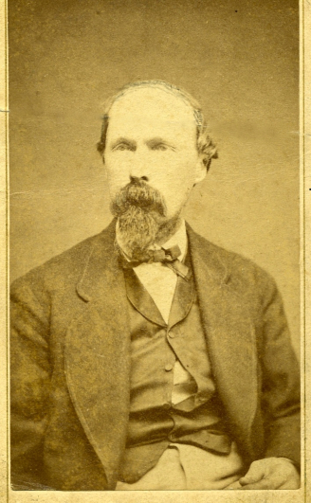
Dr. Samuel A. Mudd
was born and raised in Bryantown, Charles County, Maryland
came from a wealthy and educated family
earned his medical degree from what is today the University of Maryland’s medical school in 1857
did not join any army during the Civil War
was a 31 year old doctor and tobacco plantation owner when Lincoln was assassinated
was married with four young children by April 1865
was introduced to John Wilkes Booth at St. Mary’s Catholic Church in November, 1864
was entertained by Booth in his hotel in Washington in December, 1864
Dr. Samuel A. Mudd

Slide 3
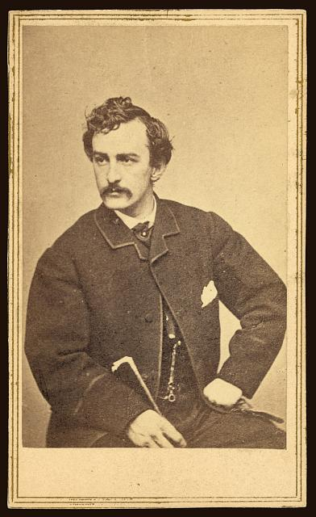
John Wilkes booth
was born and raised in Bel Air, Maryland
was a famous actor who came from a family of celebrated thespians
was an ardent supporter of the southern cause, but never served in the Confederate army
at first developed a plan to kidnap, not kill, Abraham Lincoln
visited Charles County, Maryland in November 1864 to recruit members into his plot and buy horses
met Dr. Mudd at St. Mary’s Church and spent a night at Mudd’s home
changed his plan to assassination after the surrender of the Army of Northern Virginia at Appomattox Courthouse
assassinated President Abraham Lincoln at Ford’s Theater on April 14, 1865.
fractured a bone in his left leg during the assassination
Booth escaped Washington on horseback and headed into southern Maryland in an attempt to cross the Potomac River and enter Virginia.
http://www.loc.gov/pictures/resource/ppmsca.19233/

Slide 4
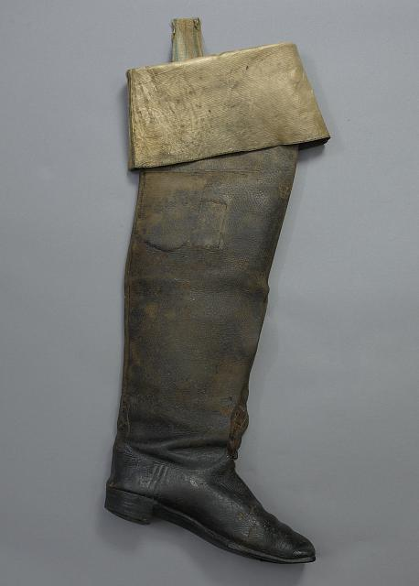
Mudd treats an “Injured Man”
Booth arrived at Dr. Mudd’s home at 4 a.m. the morning after the assassination with David Herold, one of his co-conspirators.
The Mudds claimed that the men were using the alias’s “Tyson” and “Tyler” and that the “injured man” had a long, heavy beard.
The “injured man” was helped into Mudd’s parlor and placed on the couch
The “injured man’s” boot was cut from his leg and a quick examination revealed a broken bone just above the left ankle
The “injured man” was helped upstairs and the bone was set
The “injured man” rested in the upstairs room until 4 or 5 pm, when he and his companion left the Mudd farm
As the two men left the house, Mrs. Mudd noticed that the “injured man” was wearing a fake beard. This scared her and she urged the men to leave her home.
http://www.loc.gov/pictures/resource/highsm.04758/

Slide 5
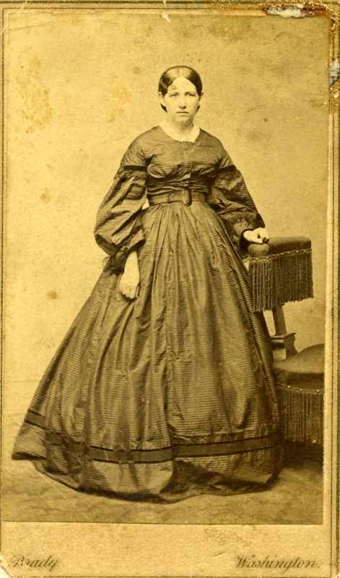
Historical Questions
Dr. Mudd was arrested a week after Booth was at his farm, put on trial, and received a life sentence for his part in helping Booth escape.
Dr. Mudd was pardoned in 1869 and returned to his home. He lived there until his death in 1883.
To this day, Dr. Mudd is considered a controversial character in the Lincoln assassination.
As a result, many questions surround Dr. Mudd’s association with John Wilkes Booth…
How did Dr. Mudd not recognize Booth, despite having met him on two prior occasions?
What did Dr. Mudd know about how the “injured man” had broken his leg?
When did Dr. Mudd realize something was amiss with the “injured man’s” story?
When he realized something was amiss with the “injured man” what did he do about it?
Mrs. Sarah F. Mudd

Slide 6
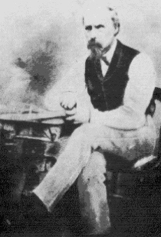
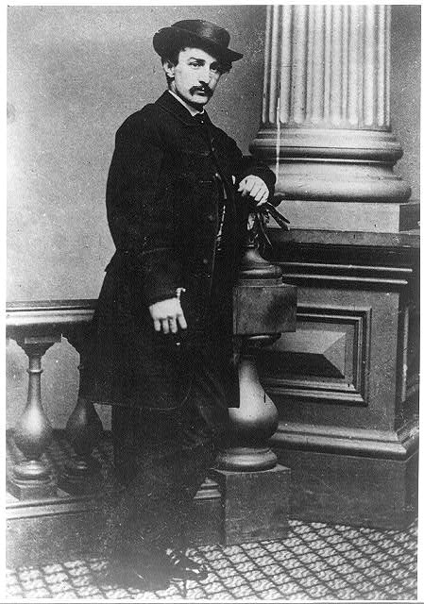
Essential Question:
When did Dr. Mudd recognize the “injured man” as John Wilkes Booth?
http://www.loc.gov/pictures/item/2001695977/
http://www.loc.gov/pictures/resource/cph.3a26098/

